Slide 1
Chapter 8
Advanced SQL

Slide 2
Chapter 7 Review
ADDING TABLE ROWS
Insert row (21225,'Bryson,iNC.','Smithson','615','223-3234','TN','Y') to table VENDOR.
  INSERT INTO vendor VALUES (21225,'Bryson,iNC.','Smithson','615','223-3234','TN','Y')

Slide 3
Chapter 7 Review
UPDATE TABLE ROWS
  Change P_INDATE from December 13,2013 to '2014-11-18 11:11:11‘ in the second row of the PRODUCT table, use the primary key(13-Q2/P2) to locate the correct row.
  UPDATE PRODUCT
  SET P_INDATE='2014-11-18 11:11:11'
  WHERE P_CODE='13-Q2/P2';

Slide 4
Chapter 7 Review
  Comparison Operators.
  Select P_DESCRIPT, P_INDATE,P_PRICE,V_CODE from PRODUCT and V_CODE not equal to 21344.
    SELECT P_DESCRIPT, P_INDATE, P_PRICE, V_CODE
    FROM product
    WHERE V_CODE<>21344;

Slide 5
Chapter 7 Review
  BETWEEN Operators.
  Select all products whose prices are between $50 and $100.
    SELECT *
    FROM PRODUCT
    WHERE P_PRICE BETWEEN 50.00 AND 100.00;

Slide 6
Chapter 7 Review
  IS NULL Operators.
  List all products that do not have a vendor assigned (V_CODE is null)
    SELECT P_CODE, P_DESCRIPT, V_CODE
    FROM PRODUCT
    WHERE V_CODE IS NULL;

Slide 7
Chapter 7 Review
  EXISTS Operators.
  List all vendors if the P_QOH< double the minimum quantity.
    SELECT *
    FROM VENDOR
    WHERE EXISTS(SELECT * FROM PRODUCT WHERE P_QOH<P_MIN*2);

Slide 8
Chapter 7 Review
  Copying parts of tables.
      CREATE TABLE PART(
      PART_CODE CHAR(8),
      PART_DESCRIPT CHAR(35),
      PART_PRICE DECIMAL(8,2),
      V_CODE INTEGER,
      PRIMARY KEY(PART_CODE));
      INSERT INTO PART (PART_CODE, PART_DESCRIPT, PART_PRICE,V_CODE)
      SELECT P_CODE, P_DESCRIPT, P_PRICE,V_CODE FROM product;

Slide 9
Chapter 7 Review
  Delete a table form the database.
    DROP TABLE PART;

Slide 10
Learning Objectives
In this chapter, the student will learn:
  How to use the advanced SQL JOIN operator syntax
  About the different types of subqueries and correlated queries
  How to use SQL functions to manipulate dates, strings, and other data
  About the relational set operators UNION, UNION ALL, INTERSECT, and MINUS

Slide 11
Learning Objectives
In this chapter, the student will learn:
  How to create and use views and updatable views
  How to create and use triggers and stored procedures
  How to create embedded SQL

Slide 12
SQL Join Operators
Relational join operation merges rows from two tables and returns rows with one of the following
  Natural join - Have common values in common columns
  Equality or inequality - Meet a given join condition
  Outer join: Have common values in common columns or have no matching values
Inner join: Only rows that meet a given criterion are selected

Slide 13
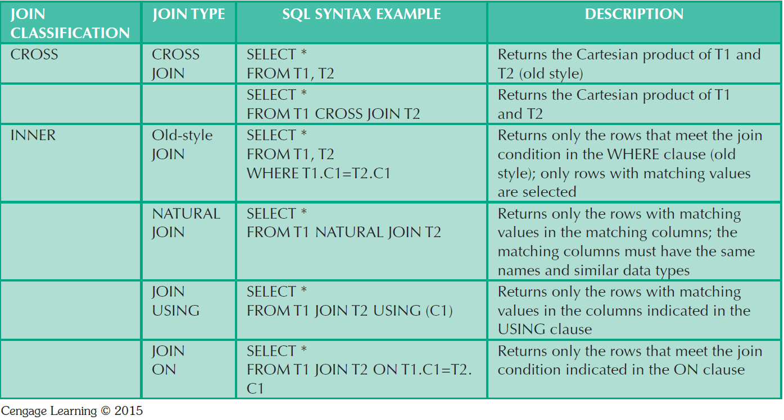
Table 8.1 - SQL Join Expression Styles

Slide 14
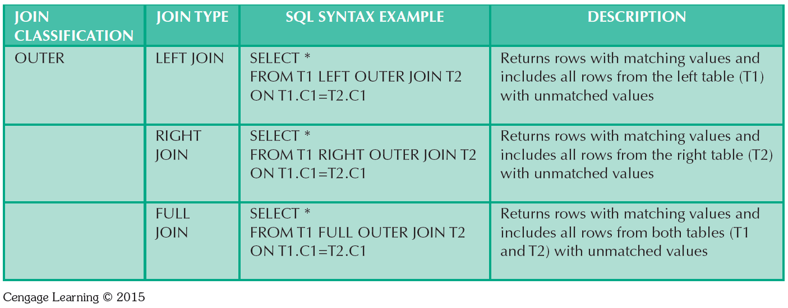
Table 8.1 - SQL Join Expression Styles

Slide 15
SQL CROSS JOIN
Cross join of the INVOICE and LINE tables that generates 144 rows (There are 8 invoice rows and 18 line rows, yielding 8*18=144 rows)
SELECT * FROM invoice CROSS JOIN line

Slide 16
SQL CROSS JOIN
Cross join can yield only specified attributes.
SELECT INVOICE.INV_NUMBER,
CUS_CODE,INV_DATE,P_CODE
FROM INVOICE CROSS JOIN LINE;
SELECT INVOICE.INV_NUMBER,CUS_CODE, INV_DATE,P_CODE
FROM INVOICE, LINE;

Slide 17
NATURAL JOIN
A natural join of the CUSTOMER and INVOICE tables and returns only selected attributes:
SELECT CUS_CODE,CUS_LNAME,INV_NUMBER,INV_DATE
FROM CUSTOMER NATURAL JOIN INVOICE;

Slide 18
NATURAL JOIN
We can perform a natural join of the INVOICE, LINE, and PRODUCT tables and project only selected attributes :
SELECT INV_NUMBER, P_CODE, P_DESCRIPT, LINE_UNITS,
LINE_PRICE
FROM INVOICE NATURAL JOIN PRODUCT NATURAL JOIN LINE;

Slide 19
JOIN USING CLAUSE
A second way to express as join is through the USING keyword.
  SELECT INV_NUMBER, P_CODE, P_DESCRIPT,
  LINE_UNITS, LINE_PRICE
  FROM INVOICE JOIN LINE USING (INV_NUMBER)
  JOIN PRODUCT USING (P_CODE);

Slide 20
JOIN ON CLAUSE
Another way to express a join when the tables have no common attribute names is to use the JOIN ON operand.
  SELECT INVOICE.INV_NUMBER, PRODUCT.P_CODE, P_DESCRIPT, LINE_UNITS, LINE_PRICE
  FROM INVOICE JOIN LINE ON INVOICE.INV_NUMBER=LINE.INV_NUMBER
  JOIN PRODUCT ON LINE.P_CODE=PRODUCT.P_CODE;

Slide 21
JOIN ON CLAUSE
JOIN ON syntax can perform a join even when the tables do not share a common attribute name.
Try to generate a list of all employees with the mangers’ names:
  SELECT DISTINCT E.EMP_MGR, M.EMP_LNAME, E.EMP_NUM,E.EMP_LNAME
  FROM EMP E JOIN EMP M ON E.EMP_MGR=M.EMP_NUM
  ORDER BY E.EMP_MGR;

Slide 22
OUTER JOINS
List the product code, vendor code, and vendor name for all products and includes those vendors with no matching products.
SELECT P_CODE, VENDOR.V_CODE, V_NAME
  FROM VENDOR LEFT JOIN PRODUCT ON VENDOR.V_CODE=PRODUCT.V_CODE;

Slide 23
OUTER JOINS
List the product code, vendor code, and vendor name for all products and includes products that do not have a matching vendor code:
SELECT P_CODE, VENDOR.V_CODE, V_NAME
  FROM VENDOR RIGHT JOIN PRODUCT ON VENDOR.V_CODE=PRODUCT.V_CODE;

Slide 24
Subqueries and Correlated Queries
Subquery is a query inside another query
Subquery can return:
  One single value - One column and one row
  A list of values - One column and multiple rows
  A virtual table - Multicolumn, multirow set of values
  No value - Output of the outer query might result in an error or a null empty set

Slide 25
Subqueries and Correlated Queries
  Generate a list of vendors who do not provide products. (Not all vendors in the VENDOR table have provided products-some are only potential vendors)
    SELECT V_CODE, V_NAME FROM VENDOR
    WHERE V_CODE NOT IN
    (SELECT V_CODE
    FROM PRODUCT
    WHERE V_CODE IS NOT NULL);

Slide 26
Subqueries and Correlated Queries
  Generate a list of all products with a price greater than or equal to the average product price.
  SELECT P_CODE,P_PRICE FROM PRODUCT
  WHERE P_PRICE>=(SELECT AVG(P_PRICE)
  FROM PRODUCT);

Slide 27
Subqueries and Correlated Queries
  A subquery is a query (SELECT statement) inside another query
  A subquery is normally expressed inside parentheses
  The first query in the SQL statement is known as the outer query
  The query inside the SQL statement is known as the inner query
  The inner query is executed first
  The output of an inner query is used as the input of the outer query
  The entire SQL statement is sometimes referred to as a nested query.

Slide 28
Subqueries and Correlated Queries
Deletes the PRODUCT table rows provided by vendors with an area code equal to 615.
  DELETE FROM PRODUCT
  WHERE V_CODE IN (SELECT V_CODE FROM VENDOR WHERE V_AREACODE='615')

Slide 29
WHERE Subqueries
Uses inner SELECT subquery on the right side of a WHERE comparison expression
Value generated by the subquery must be of a comparable data type
If the query returns more than a single value, the DBMS will generate an error
Can be used in combination with joins

Slide 30
WHERE Subqueries
List all customers who ordered a claw hammer.
  SELECT DISTINCT CUS_CODE, CUS_LNAME, CUS_FNAME
  FROM CUSTOMER JOIN INVOICE USING (CUS_CODE)
  JOIN LINE USING (INV_NUMBER)
  JOIN PRODUCT USING (P_CODE)
  WHERE P_CODE=(SELECT P_CODE FROM PRODUCT WHERE P_DESCRIPT='Claw hammer')

Slide 31
WHERE Subqueries
List all customers who ordered a claw hammer.
  SELECT DISTINCT CUS_CODE, CUS_LNAME, CUS_FNAME
  FROM CUSTOMER JOIN INVOICE USING (CUS_CODE)
  JOIN LINE USING (INV_NUMBER)
  JOIN PRODUCT USING (P_CODE)
  WHERE P_DESCRIPT='Claw hammer';

Slide 32
IN and HAVING Subqueries
IN subqueries
  Used to compare a single attribute to a list of values
HAVING subqueries
  HAVING clause restricts the output of a GROUP BY query by applying conditional criteria to the grouped rows

Slide 33
IN and HAVING Subqueries
List all customers who have purchased hammers, saws, or saw blades.
    SELECT distinct CUS_CODE, CUS_LNAME, CUS_FNAME
    FROM CUSTOMER JOIN INVOICE USING (CUS_CODE)
    JOIN LINE USING (INV_NUMBER)
    JOIN PRODUCT USING (P_CODE)
    WHERE P_CODE IN (SELECT P_CODE FROM PRODUCT
    WHERE P_DESCRIPT LIKE '%hammer%'
    OR P_DESCRIPT LIKE '%saw%');

Slide 34
IN and HAVING Subqueries
List all products with a total quantity sold greater than the average quantity sold.
  SELECT P_CODE, SUM(LINE_UNITS)
  FROM LINE
  GROUP BY P_CODE
  HAVING SUM(LINE_UNITS)>(SELECT AVG(LINE_UNITS)FROM LINE);

Slide 35
Multirow Subquery Operators:
ANY and ALL
ALL operator
  Allows comparison of a single value with a list of values returned by the first subquery
    Uses a comparison operator other than equals
ANY operator
  Allows comparison of a single value to a list of values and selects only the rows for which the value is greater than or less than any value in the list

Slide 36
Multirow Subquery Operators:
ANY and ALL
Which products cost more than all individual products provided by vendors from Florida?
Products cost=P_QOH*P_PRICE
    SELECT P_CODE,P_QOH*P_PRICE
    FROM PRODUCT
    WHERE P_QOH*P_PRICE>=ALL(SELECT P_QOH*P_PRICE
    FROM product
    WHERE V_CODE IN
    (SELECT V_CODE FROM vendor
    WHERE V_STATE='FL'));

Slide 37
Multirow Subquery Operators:
ANY and ALL
Which products cost more than all individual products provided by vendors from Florida?
Products cost=P_QOH*P_PRICE
    SELECT p1.P_CODE,p1.P_QOH*P_PRICE FROM product p1
    WHERE (p1.P_QOH*p1.P_PRICE) >= ALL
    (SELECT (p2.P_PRICE*p2.P_QOH) FROM product p2, vendor v
    WHERE p2.v_code= v.v_code AND v_state='FL');

Slide 38
FROM Subqueries
FROM clause:
  Specifies the tables from which the data will be drawn
  Can use SELECT subquery

Slide 39
Attribute List Subqueries
SELECT statement uses attribute list to indicate what columns to project in the resulting set
Inline subquery
  Subquery expression included in the attribute list that must return one value
Column alias cannot be used in attribute list computation if alias is defined in the same attribute list

Slide 40
Attribute List Subqueries
List the difference between each product’s price and the average product price.
  SELECT P_CODE, P_PRICE,(SELECT AVG(P_PRICE)FROM
  PRODUCT)AS AVGPRICE,
  P_PRICE-(SELECT AVG(P_PRICE)FROM PRODUCT) AS
  DIFF
  FROM PRODUCT;

Slide 41
Attribute List Subqueries
List the product, the total sales by product, and the contribution per employee of each product’s sales.
Use LINE table to get the sales by product.
Use EMP table to compute the contribution by employee.
    SELECT P_CODE, SUM(LINE_UNITS*LINE_PRICE) AS SALES,
    (SELECT COUNT(*) FROM EMP) AS ECOUNT,
    SUM(LINE_UNITS*LINE_PRICE)/(SELECT COUNT(*) FROM EMP) AS
    CONTRIB
    FROM LINE
    GROUP BY P_CODE;

Slide 42
Attribute List Subqueries
List the product, the total sales by product, and the contribution per employee of each product’s sales.
  SELECT P_CODE,SALES, ECOUNT, SALES/ECOUNT AS CONTRIB
  FROM (SELECT P_CODE, SUM(LINE_UNITS*LINE_PRICE) AS SALES,
  (SELECT COUNT(*) FROM EMP) AS ECOUNT
  FROM LINE
  GROUP BY P_CODE) A;

Slide 43
Correlated Subquery
Executes once for each row in the outer query
Inner query references a column of the outer subquery
The process is similar to the typical nested loop in a programming language:
    FOR X=1 TO 2
      FOR Y=1 TO 3
        PRINT X, Y
      END
    END

Slide 44
Correlated Subquery
List all product sales in which the units sold value is greater than the average units sold value of that product.
    SELECT INV_NUMBER, P_CODE, LINE_UNITS
    FROM LINE LS
    WHERE LS.LINE_UNITS>(SELECT AVG(LINE_UNITS)
    FROM LINE LA
    WHERE LA.P_CODE=LS.P_CODE);

Slide 45
Correlated Subquery
List the name of all customer who have placed an order lately.
    SELECT CUS_CODE,CUS_LNAME, CUS_FNAME
    FROM CUSTOMER
    WHERE EXISTS (SELECT CUS_CODE FROM invoice
    WHERE INVOICE.CUS_CODE=CUSTOMER.CUS_CODE)

Slide 46
Correlated Subquery
List the name of all customer who have placed an order lately.
    SELECT CUS_CODE,CUS_LNAME, CUS_FNAME
    FROM CUSTOMER
    WHERE CUS_CODE IN (SELECT CUS_CODE FROM invoice
    WHERE INVOICE.CUS_CODE=CUSTOMER.CUS_CODE)

Slide 47
Correlated Subquery
List all vendors you must contact to order products that are approaching the minimum quantity-on-hand value.
Show the vendor code and vendor name for products with a quantity on hand that is less that double the minimum quantity.
      SELECT V_CODE, V_NAME
      FROM VENDOR
      WHERE EXISTS (SELECT *
      FROM PRODUCT
      WHERE P_QOH<P_MIN*2
      AND VENDOR.V_CODE=PRODUCT.V_CODE);

Slide 48
Correlated Subquery
List all vendors you must contact to order products that are approaching the minimum quantity-on-hand value.
Show the vendor code and vendor name for products with a quantity on hand that is less that double the minimum quantity.
      SELECT V_CODE, V_NAME
      FROM VENDOR
      WHERE V_CODE IN (SELECT VENDOR.V_CODE
      FROM PRODUCT
      WHERE P_QOH<P_MIN*2
      AND VENDOR.V_CODE=PRODUCT.V_CODE);

Slide 49
SQL Functions
Functions always use a numerical, date, or string value
Value may be part of a command or may be an attribute located in a table
Function may appear anywhere in an SQL statement where a value or an attribute can be used

Slide 50
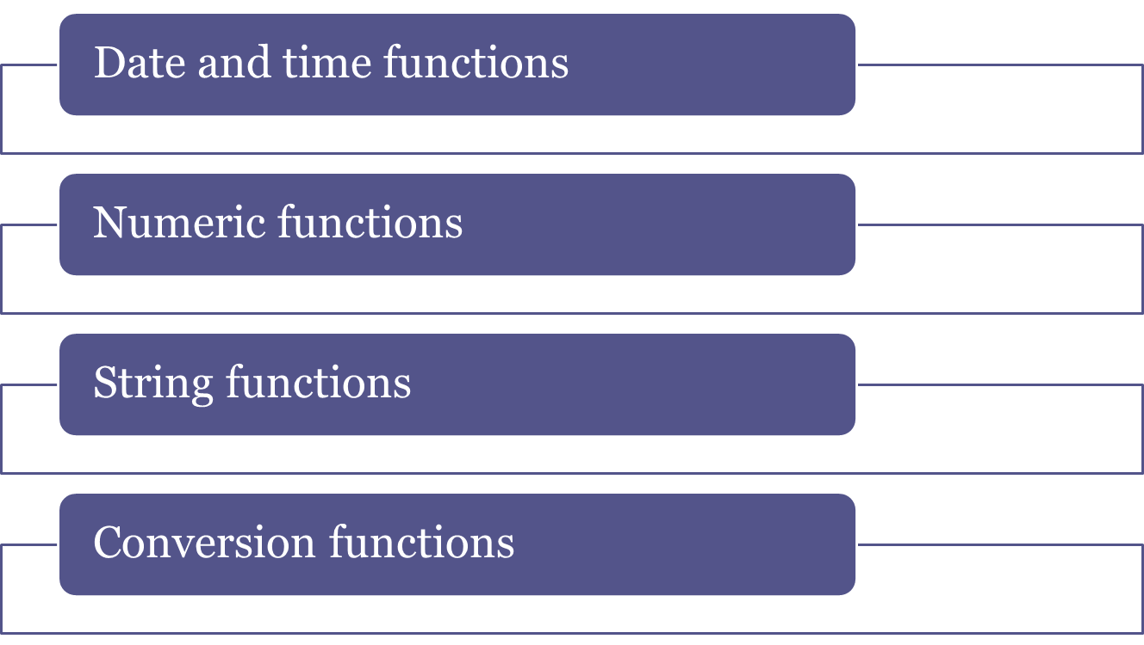
SQL Functions

Slide 51
SQL Functions
Display the product code and the date the product was last received into stock for all products:
  SELECT P_CODE, TO_CHAR(P_INDATE,'yyyymmdd')
  FROM PRODUCT;
  SELECT P_CODE, TO_CHAR(P_INDATE,'yyyy/mm/dd')
  FROM PRODUCT;

Slide 52
SQL Functions
Display the product code and the date the product was last received into stock for all products:
  SELECT product.P_CODE, product.P_INDATE FROM invoice
  JOIN line ON invoice.INV_NUMBER=line.INV_NUMBER
  JOIN product ON line.P_CODE=product.P_CODE;

Slide 53
SQL Functions
List all employees born in 1972.
  SELECT EMP_LNAME,EMP_FNAME, EMP_DOB,EXTRACT(year FROM EMP_DOB) AS year
  FROM EMP
  WHERE EXTRACT(year FROM EMP_DOB)=1972;

Slide 54
SQL Functions
List all employees born in November.
  SELECT EMP_LNAME,EMP_FNAME, EMP_DOB
  FROM EMP
  WHERE EXTRACT(month FROM EMP_DOB)='11'

Slide 55
SQL Functions
List all employees born on the 14th day of the month.
  SELECT EMP_LNAME,EMP_FNAME, EMP_DOB,
  EXTRACT(day FROM EMP_DOB) AS day
  FROM EMP
  WHERE EXTRACT(day FROM EMP_DOB)='14';

Slide 56
SQL Functions
List all products with the date they will have been on the shelf for 30 days.
  SELECT P_CODE, P_INDATE,P_INDATE+30 AS plus_30
  FROM PRODUCT
  ORDER BY P_INDATE+30;

Slide 57
SQL Functions
List all products with their expiration date (two years from the P_INDATE):
  SELECT P_CODE, P_INDATE,add_months(P_INDATE,12*2) FROM PRODUCT
  ORDER BY add_months(P_INDATE,12*2);

Slide 58
SQL Functions
List all employees who were hired within the last seven days of a month.
  SELECT EMP_LNAME, EMP_FNAME, EMP_HIRE_DATE
  FROM EMP
  WHERE EMP_HIRE_DATE>=LAST_DAY(EMP_HIRE_DATE)-7;

Slide 59
Numeric Functions
ABS:
  SELECT 1.95,-1.93, ABS (19.5),ABS(-19.3);
ROUND: List the product prices rounded to one and zero decimal places.
    SELECT P_CODE, P_PRICE, ROUND(P_PRICE, 1) AS
    PRICE1,
    ROUND(P_PRICE,0) AS PRICE0
    FROM PRODUCT;

Slide 60
Numeric Functions
ABS:
  SELECT 1.95,-1.93, ABS (19.5),ABS(-19.3);
TRUNC:
  SELECT P_CODE, P_PRICE, TRUNC(P_PRICE, 1) AS
  PRICE1,
  ROUND(P_PRICE,0) AS PRICE0
  FROM PRODUCT;

Slide 61
Numeric Functions
CEIL/CEILING/FLOOR
List the product price, the smallest integer greater than or equal to the product price, and the largest integer equal to or less than the product price.
  SELECT P_PRICE, CEIL(P_PRICE),FLOOR(P_PRICE)
  FROM PRODUCT;

Slide 62
String Functions
Concatenation
List all employee names and return a single column.
  SELECT concat(concat(EMP_LNAME,','), EMP_FNAME) AS NAME
  FROM EMP

Slide 63
String Functions
UPPER,LOWER.
Returns a string in all capital or all lowercase letters.
  SELECT UPPER(CONCAT(CONCAT(EMP_LNAME,','),EMP_FNAME))AS NAME
  FROM EMP

Slide 64
String Functions
SUBSTRING
Lists the first three characters of all employee phone number.
SELECT EMP_PHONE, SUBSTR(EMP_PHONE,1,3) AS
PREFIX
FROM EMP;

Slide 65
String Functions
LENGTH
Lists all employee last names and the length of their name in descending order by last name length.
  SELECT EMP_LNAME, LENGTH(EMP_LNAME) AS NAMESIZE
  FROM EMP;

Slide 66
Conversion Functions
Conversion functions allow you to take a value of a given data type and convert it to the equivalent value in another data type.
MySQL: CAST, CONVERT
List all product prices, product received date, and percent discount using formatted values.
    SELECT P_CODE, CAST(P_PRICE AS CHAR(8)) AS PRICE,
    CAST(P_INDATE AS CHAR(20)) AS INDATE,
    CAST(p_DISCOUNT AS CHAR(4)) AS DISC
    FROM PRODUCT;

Slide 67
Conversion Functions
  List all product prices, product received date, and percent discount using formatted values.
    SELECT
    P_CODE,
    CONVERT(P_PRICE, CHAR(8)) AS PRICE,
    CONVERT(P_INDATE, CHAR(20)) AS INDATE,
    CONVERT(p_DISCOUNT, CHAR(4)) AS DISC
    FROM
    PRODUCT;

Slide 68
Conversion Functions
  Converts text strings to numeric values when importing data to a tale from another source in text format.
    SELECT P_CODE,CAST('-123.66'AS DECIMAL(8,2)) AS PRICE,
    CAST('-99.78' AS DECIMAL(8,2)) AS NEW_PRICE
    FROM product;

Slide 69
Conversion Functions
Returns the sales tax rate for specified states:
    Compare V_STATE to ‘CA’; if the values match, it returns 0.08.
    Compare V_STATE to ‘FL’; if the values match, it returns 0.05.
    Compare V_STATE to ‘TN’; if the values match, it returns 0.085.
    If there is no match, it returns 0.00 (the default value).
        SELECT V_CODE, V_STATE,
        CASE WHEN V_STATE = 'CA' THEN 0.08
        WHEN V_STATE = 'FL' THEN 0.05
        WHEN V_STATE = 'TN' THEN 0.085
        ELSE 0.00 END AS TAX
        FROM VENDOR

